Slide 1
Knowledge Development and Ownership in a Global Society: Reflections on Educational Progress in Anglophone Caribbean
Dr Gertrude Shotte
Knowledge, Innovation and Enterprise International Conference
University of Greenwich, London
10 – 13 September 2013

Slide 2
Aim / Purpose
To provoke thought on the development of knowledge in Anglophone Caribbean.
To inspire reflections on knowledge ownership in ‘post-colonial’ educational institutions.
To highlight the challenges and obstacles that frustrate educational progress in Higher Education in Anglophone Caribbean.
To have a closer look at Regionalism as the catalyst for the promotion of educational progress in Higher Education Institutions.

Slide 3
An investment in knowledge pays the best interest – Benjamin Franklin.
The expert knows more and more about less and less until he knows everything about nothing – Mahatma Ghandi.
Valuing knowledge above all else results in a lust for power, and that leads men into dark and empty places – Veronica Roth.
Bodily exercise, when compulsory, does no harm to the body; but knowledge which is acquired under compulsion obtains no hold on the mind – Plato.

Slide 4
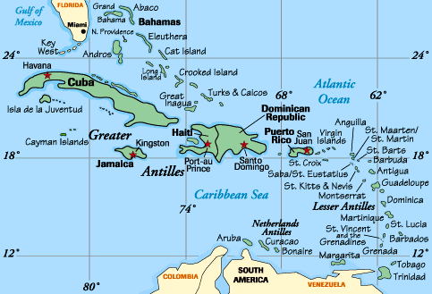
The Caribbean

Slide 5
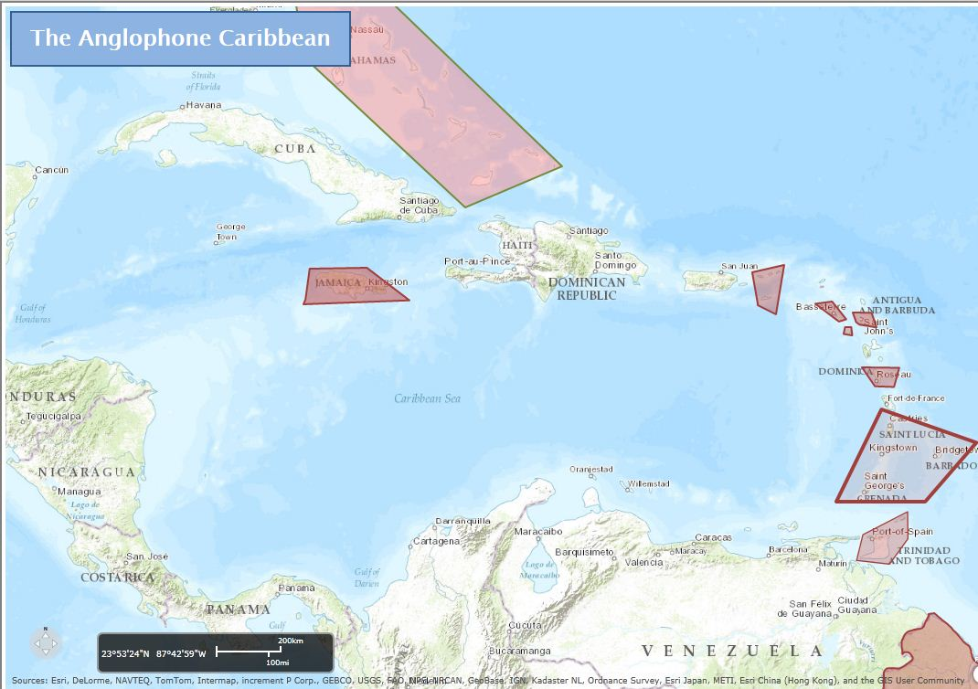

Slide 6
University of the West Indies (UWI): 4 Campuses, 16 Nations
Cave Hill Campus – Barbados
Mona campus – Jamaica
St. Augustine Campus – Trinidad & Tobago
Open Campus

Slide 7
Knowledge & Knowledge Development
An Online Oxford Dictionary: facts, information, and skills acquired through experience or education; the theoretical or practical understanding of a subject.
“Critical thinking (CT) is increasingly being recognized as the cognitive engine driving the processes of knowledge development and professional judgment in a wide variety of professional practice fields” (Facione & Facione, 1996).
Universities play a crucial role in generating new ideas, and in accumulating and transmitting knowledge, yet they have remained peripheral to development concerns.
... the knowledge development as it relates to human capital in order to ensure economic competitiveness, the connection of the educational system to the leading edge of technology and business practices, and availability of complementary knowledge from different actors (Central Europe, 2013),

Slide 8
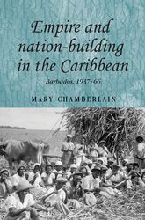
Knowledge and Nation Building
Knowledge development - crucial to national development /nation building

Slide 9
Critical Thinking
"We understand critical thinking to be purposeful, self-regulatory judgment which results in interpretation, analysis, evaluation, and inference, as well as the explanation of the evidential, conceptual, methodological, criteriological, or contextual considerations upon which that judgment was based." (Facione and Facion, 1996)

Slide 10
Colonialism: Conceptualisations and Re-conceptualisations
“Colonialism is a practice of domination, which involves the subjugation of one people to another... imperialism draws attention to the way that one country exercises power over another, whether through settlement, sovereignty, or indirect mechanisms of control” (Kohn, 2012).
“...not as a sub-plot of some ‘grander’ (European) narrative, but as a violent process central to the development of globalisation” (Tikly and Bond, 2013, p.424).

Slide 11
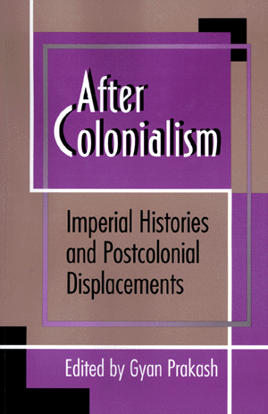
Knowledge Ownership, Post-colonialism and Neo-colonialism
“...echoes excesses committed under colonialism... amplified by the continuing hegemony of Western forms of knowledge and views of ethics as part of the new global discourse of development” (Tikly and Bond, 2013; Escobar, 1995).
...Western knowledge claims dominance over, and tend to ignore other methods and tactical ways to understanding the world (Santos 2007; santos, 2012)

Slide 12
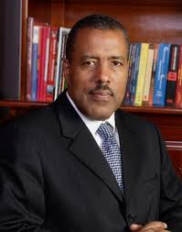
UWI: Commitments and Challenges
Committed to preserving its regional (Caribbean) character.
...accelerating pace of change influenced by rapidly evolving technologies, rapid globalisation and highly liberalised trading arrangements for goods and services, including Higher Education (Professor Gordon Shirley).

Slide 13
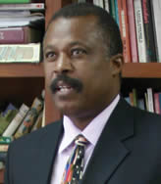
UWI: A Site of Resistance for the Region
...when economic industries are threatened by global capitalism...
... a third communications-driven phase of globalisation... A contradictory process which we misread to our peril. On one hand, the global agenda speaks to openness and borderlessness; but on the other hand, we see that its fundamental building block remains the ‘nation-state’ (Professor Hilary Beckles).

Slide 14
UWI: A Diluted Rich Cultural ‘Student’ Blend
The incursion of foreign institutions into the educational landscape as well as the aggressive marketing and promotion strategies by foreign universities to attract students to study abroad have also affected the UWI student population overall.
... Need for productive and mutually supportive partnerships with national colleges with a view to building a Higher Education network (Professor Hazel Simmons-McDonald)

Slide 15
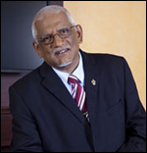
UWI: A Problem-solving Institution
... It is important to remember that Caribbean States were forged by a common history of colonisation ...
... where both students and faculty are engaged in creative thinking, problem solving and research so as to develop sustainable regional responses to the peculiar needs of our Caribbean countries ... (Professor Clement Sankat)

Slide 16
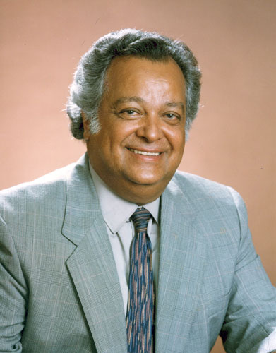
‘Is the West Indies West Indian?’
... each allowed the stigma of otherness, even foreignness, to degrade our West Indian kinship. The fault lies not only in our political stars but also in ourselves that we are what and where we are; and what and where we will be in a global society that demands of us the very best we can be (Sir Shridaph Ramphal)

Slide 17
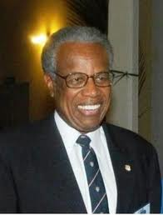
‘Restoring the West Indies in UWI’
Navigation of the digital cosmos via an information infrastructure that allow its users to defy distance and tether time ...
Creating knowledge in our University about our own reality and our products – can result in the application of local evidence to local problems, which gives more assurance of the relevance of the solutions proposed – can result in the burnishing of the UWI brand and the strengthening of institutional and regional identity (Sir George Alleyne – UWI Chancellor).

Slide 18
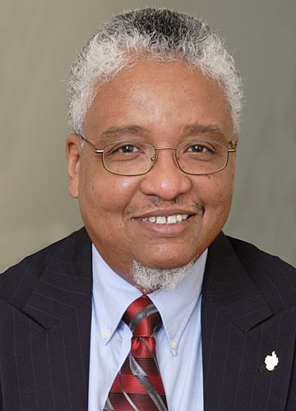
UWI and Regionalism
In my view The UWI can only be regional if its constituents are truly imbued with a culture of regionalism so that they automatically seek alliances with counterparts on sister campuses to address problems, whether these are regional or national (Professor Nigel Harris – UWI Vice Chancellor)

Slide 19
What is Regionalism?
Regionalism is a way of doing, thinking, feeling, which seeks to identify, give meaning to, acknowledge the integrity of common and unique Caribbean Communities, and also to pool these various experiences obtained from institutions and from persons in order to compel an action (CARICOM Secretariat 1993:5).

Slide 20
What Do You Think?
Is a ‘post’ postcolonial approach to knowledge creation and dissemination possible in a globalised society?
Given the ‘unspoken’ and ‘unwritten’ authority of Western thinking with regard to knowledge development and ‘ownership’, can UWI, via its educational programme effectively sustain cultural, economic and ‘geopolitical’ regionalism?

Slide 21
Thanks for your kind attention.

